Slide 1



Bicep Powershell
Justin Grote (@justinwgrote)

Slide 2
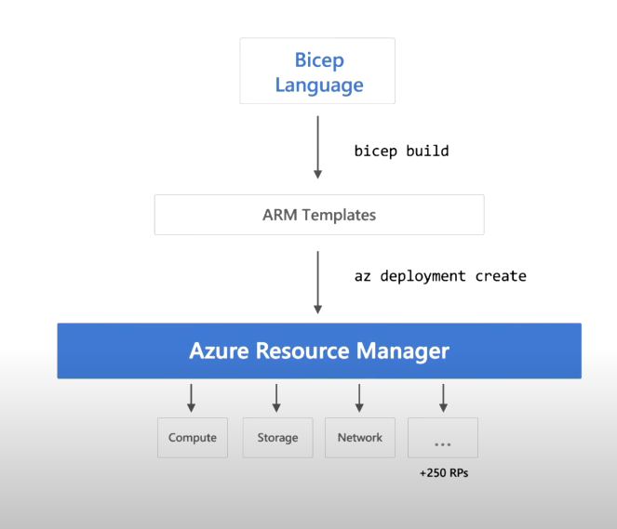
What is Bicep?

Slide 3
What is Bicep?
Build-Bicep
New-AzDeployment

Slide 4
Aka.ms/bicep
Watch the video
Get Up and Running
Do The Tutorial

